Slide 1
Anomaly Detection
Zhu yiling

Slide 2
Anomaly Detection
Autoencoders, variational autoencoders (An & Cho, 2015; Zhou & Paffenroth, 2017), energy based models (Zhai et al., 2016) and deep autoencoding Gaussian mixture models (Bo Zong, 2018) have been explored for anomaly detection

Slide 3
Image-level anomaly detection
Classification target
Adversarially Learned One-Class Classifier for Novelty Detection [ALOCC] | Mohammad Sabokrou, et al. | [CVPR' 18]
Hierarchical Novelty Detection for Visual Object Recognition | Kibok Lee, et al. | [CVPR' 18]
Deep One-Class Classification | Lukas Ruff, el al. | [ICML' 18]
Deep Anomaly Detection with Outlier Exposure | Dan Hendrycks, et al. | [ICLR' 19]
Latent Space Autoregression for Novelty Detection | Davide Abati, et al. | [CVPR' 19]
OCGAN: One-Class Novelty Detection Using GANs With Constrained Latent Representations | Pramuditha Perera, et al. | [CVPR' 19]
Notes:
https://github.com/hoya012/awesome-anomaly-detection
https://www.dlology.com/blog/how-to-do-novelty-detection-in-keras-with-generative-adversarial-network/
https://github.com/khalooei/ALOCC-CVPR2018

Slide 4
Image-level anomaly detection
Segmentation target
Unsupervised Anomaly Detection with Generative Adversarial Networks to Guide Marker Discovery [AnoGAN] | Thomas Schlegl, et al. | [IPMI' 17]
Improving Unsupervised Defect Segmentation by Applying Structural Similarity to Autoencoders | Paul Bergmann, et al. | [arXiv' 18]
Deep Autoencoding Models for Unsupervised Anomaly Segmentation in Brain MR Images | Christoph Baur, et al. | [arXiv' 18]
AVID: Adversarial Visual Irregularity Detection | Mohammad Sabokrou, et al. | [arXiv' 18]
MVTec AD -- A Comprehensive Real-World Dataset for Unsupervised Anomaly Detection | Paul Bergmann, et al. | [CVPR' 19]
Exploiting Epistemic Uncertainty of Anatomy Segmentation for Anomaly Detection in Retinal OCT | Philipp Seeböck, et al. | [IEEE TMI' 19]
Notes:
https://github.com/hoya012/awesome-anomaly-detection

Slide 5
Anomaly Detection
GAN
AnoGAN 、f-AnoGAN、GANomaly、Skip-ganomaly、Efficient-GAN、fence GAN
Structured Representations
Patch GAN、 spatial VAE、structed based VAE
VAE
VAE+GAN AAE+GAN VAE+pixel CNN
loss
SSIM loss GAN loss perceptual loss
CNN+image inpianting
Unet+Partial CNN

Slide 6
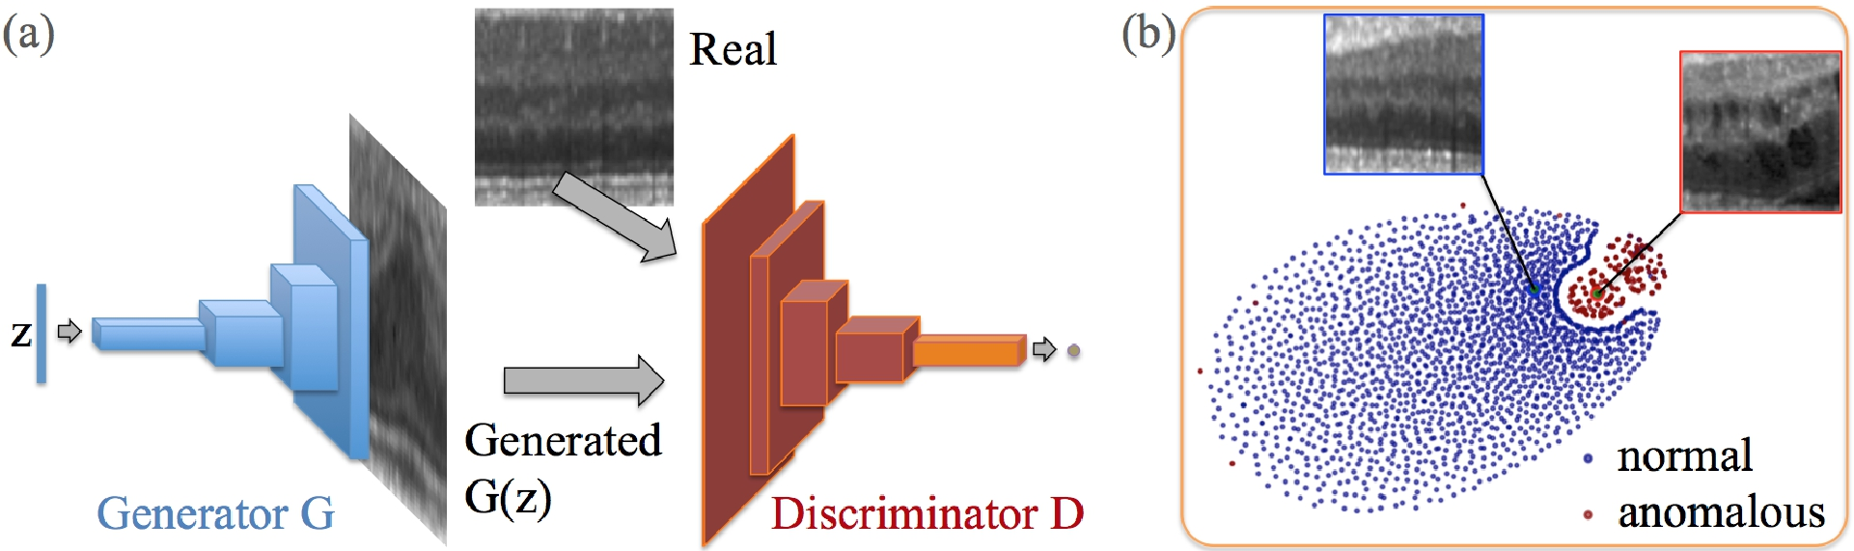
anoGAN for Unsupervised Anomaly Detection
(a) Deep convolutional generative adversarial network. (b) t-SNE embedding of normal (blue) and anomalous (red) images on the feature representation of the last convolution layer (orange in (a)) of the discriminator
Schlegl, Thomas, et al. "Unsupervised anomaly detection with generative adversarial networks to guide marker discovery." International Conference on Information Processing in Medical Imaging. Springer, Cham, 2017.
Notes:
http://tongtianta.site/paper/4538

Slide 7
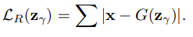
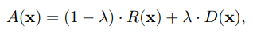
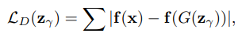
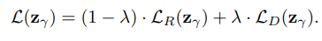
anoGAN for Unsupervised Anomaly Detection
residual loss:
Discrimination Loss:
Only the coeﬃcients of z are adapted via backpropagation. The trained parameters of the generator and discriminator are kept ﬁxed
Schlegl, Thomas, et al. "Unsupervised anomaly detection with generative adversarial networks to guide marker discovery." International Conference on Information Processing in Medical Imaging. Springer, Cham, 2017.

Slide 8
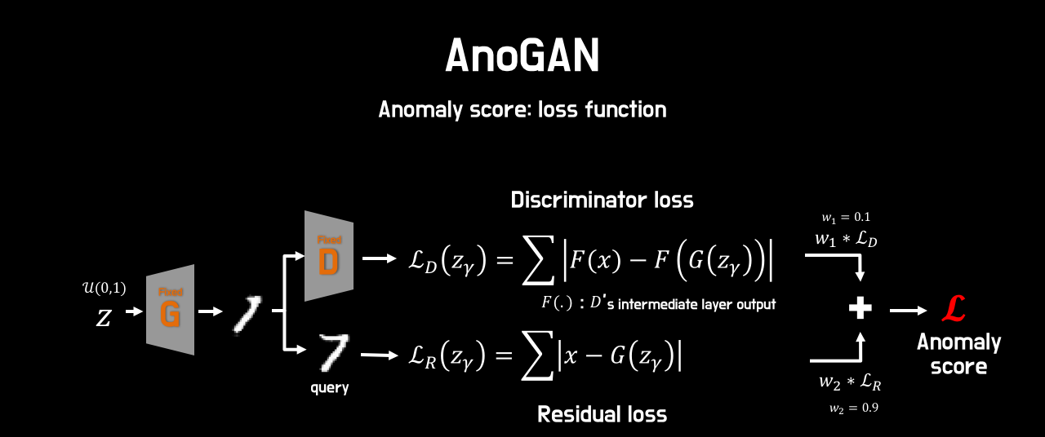
anoGAN for Unsupervised Anomaly Detection
Schlegl, Thomas, et al. "Unsupervised anomaly detection with generative adversarial networks to guide marker discovery." International Conference on Information Processing in Medical Imaging. Springer, Cham, 2017.

Slide 9
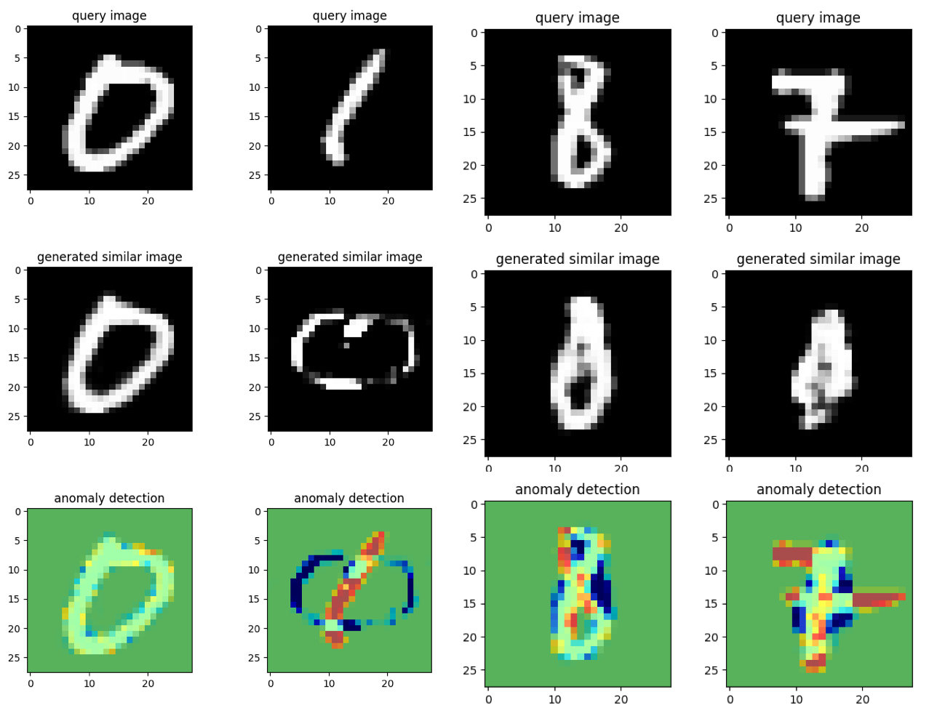
anoGAN for Unsupervised Anomaly Detection
Notes:
https://github.com/oyxhust/wgan-gp-anomaly (wgan-gp)
https://github.com/fuchami/ANOGAN (DCGAN)
https://github.com/kosyoshida/simple-keras https://github.com/tkwoo/anogan-keras
AnoGAN(code, keras) : https://github.com/yjucho1/anoGAN AnoGAN(code, tf) : https://github.com/LeeDoYup/AnoGAN

Slide 10
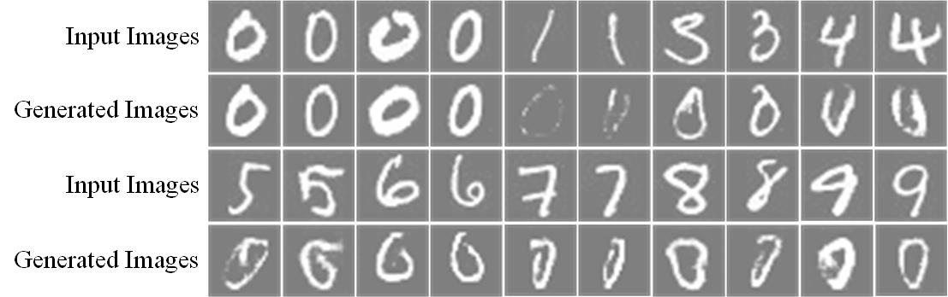
anoGAN for Unsupervised Anomaly Detection
Schlegl, Thomas, et al. "Unsupervised anomaly detection with generative adversarial networks to guide marker discovery." International Conference on Information Processing in Medical Imaging. Springer, Cham, 2017.
Notes:
https://github.com/oyxhust/wgan-gp-anomaly (wgan-gp)
https://github.com/fuchami/ANOGAN (DCGAN)
https://github.com/kosyoshida/simple-keras

Slide 11
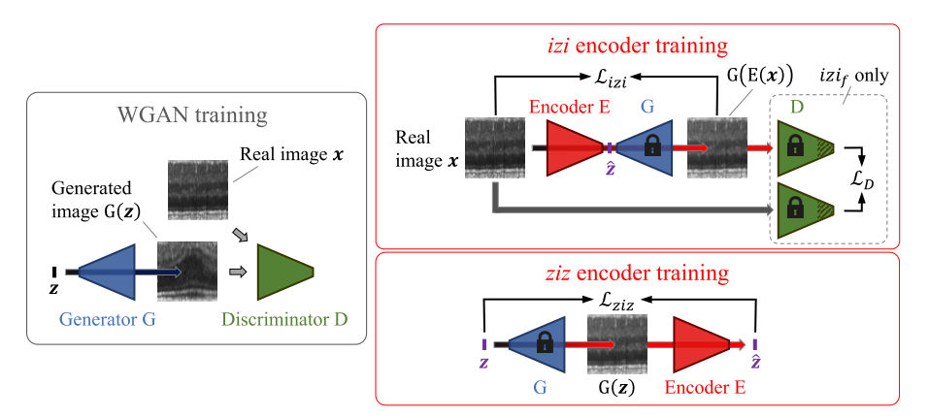
f-AnoGAN
Schlegl, Thomas, et al. "f-AnoGAN: Fast unsupervised anomaly detection with generative adversarial networks." Medical image analysis 54 (2019): 30-44.
Notes:
https://github.com/tSchlegl/f-AnoGAN

Slide 12
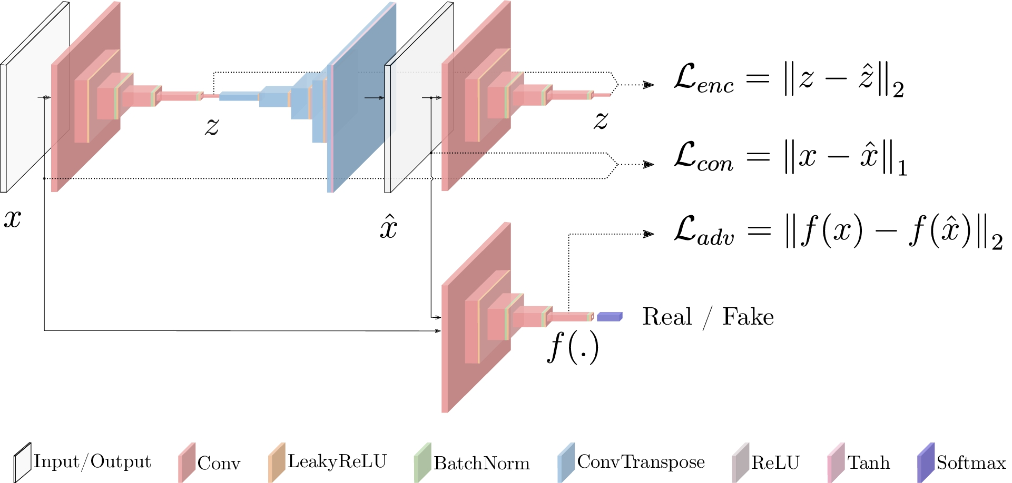
GANomaly
Akcay, Samet, Amir Atapour-Abarghouei, and Toby P. Breckon. "Ganomaly: Semi-supervised anomaly detection via adversarial training." Asian Conference on Computer Vision. Springer, Cham, 2018.
Notes:
https://github.com/WellenWoo/GANomaly-pytorch
https://github.com/aarthipriyar/GAN
https://github.com/samet-akcay/ganomaly
https://github.com/mimirobo/retina_ganomaly
https://github.com/samet-akcay/ganomaly
https://github.com/ucbtns/medgan
https://github.com/SunnerLi/GANomaly2D
https://github.com/gewenchao/anomaly-detection-semi-supervision
https://github.com/chychen/tf2-ganomaly
https://researchcode.com/code/2843279368/ganomaly-semi-supervised-anomaly-detection-via-adversarial-training/

Slide 13
GANomaly
Akcay, Samet, Amir Atapour-Abarghouei, and Toby P. Breckon. "Ganomaly: Semi-supervised anomaly detection via adversarial training." Asian Conference on Computer Vision. Springer, Cham, 2018.
Notes:
https://github.com/WellenWoo/GANomaly-pytorch
https://github.com/aarthipriyar/GAN
https://github.com/samet-akcay/ganomaly
https://github.com/Scott1123/GANomaly
https://github.com/SnowMasaya/Efficient_GAN-Based_Anomaly_Detection_Keras

Slide 14
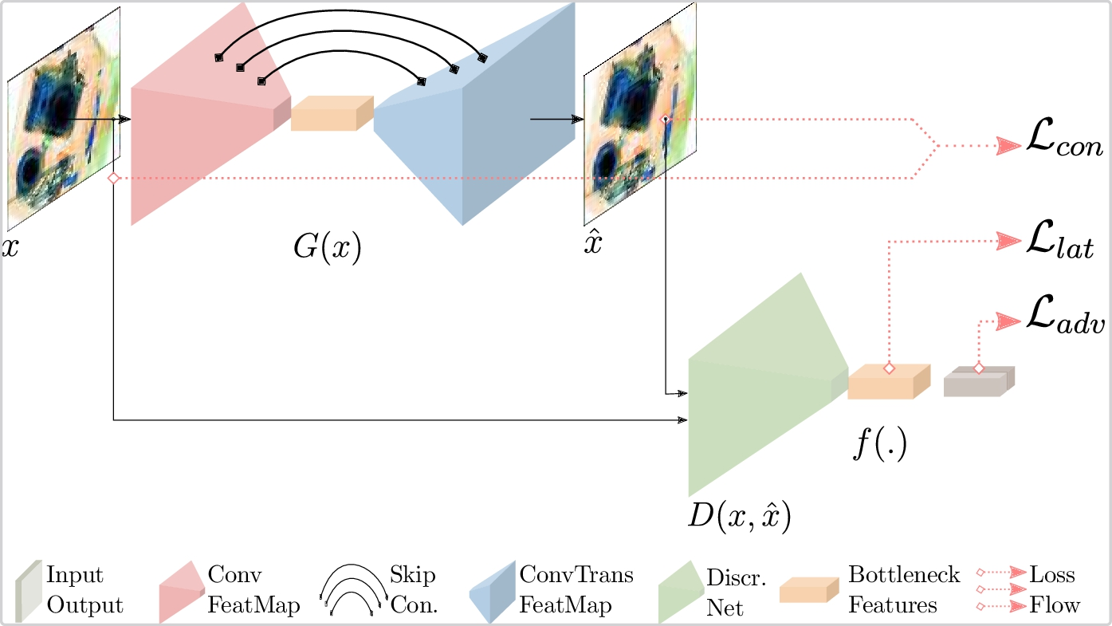
Skip-ganomaly
S. Akçay, A. Atapour-Abarghouei, T. P. Breckon, Skip-GANomaly: Skip Connected and Adversarially Trained Encoder-Decoder Anomaly Detection, in: International Joint Conference on Neural Networks (IJCNN), IEEE, 2019
Notes:
https://github.com/samet-akcay/skip-ganomaly

Slide 15
Geometric Transformations
Notes:
https://arxiv.org/abs/1805.10917v2
https://github.com/izikgo/AnomalyDetectionTransformations

Slide 16
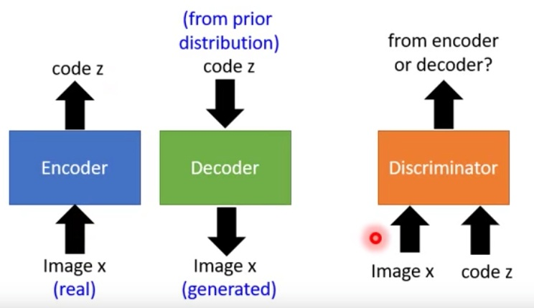
Efficient-GAN
Zenati, Houssam, et al. "Efficient gan-based anomaly detection." arXiv preprint arXiv:1802.06222 (2018).
Notes:
https://github.com/houssamzenati/Efficient-GAN-Anomaly-Detection
https://arxiv.org/abs/1904.02426v2 Efficient GAN-based method for cyber-intrusion detection
https://github.com/Forcrush/Efficient-GAN-based-method-for-cyber-intrusion基于GAN的高效网络入侵方法
https://tongtianta.site/paper/28541 Efficient GAN-Based Anomaly Detection
https://github.com/houssamzenati/Efficient-GAN-Anomaly-Detection
https://github.com/SnowMasaya/Efficient_GAN-Based_Anomaly_Detection_Keras
https://github.com/acv0209/Efficient_GAN

Slide 17
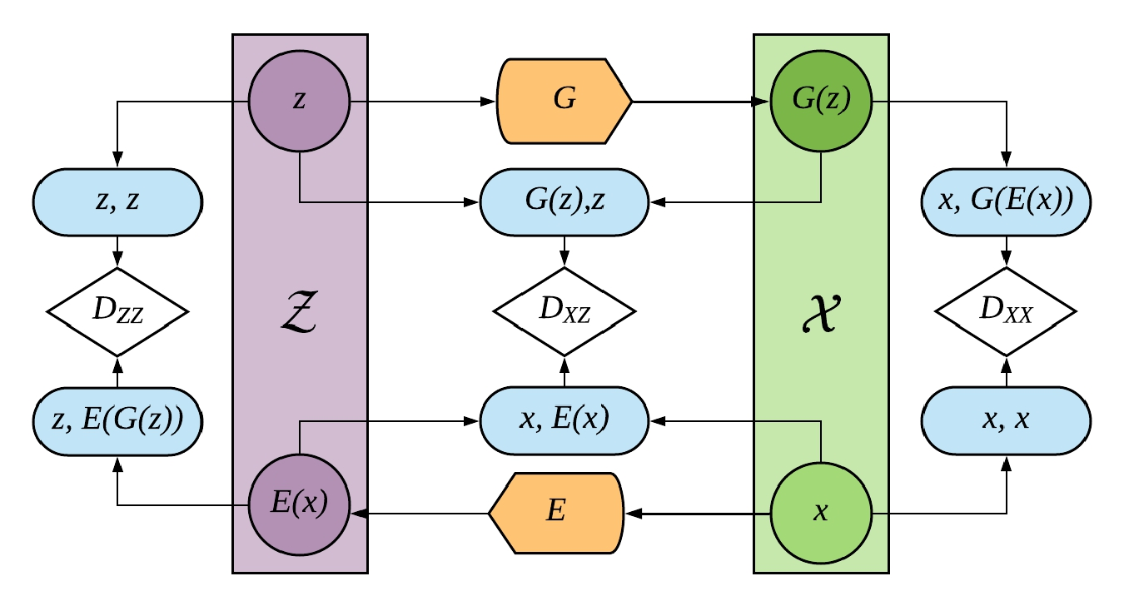
Adversarially-Learned-Anomaly-Detection
Notes:
https://arxiv.org/abs/1812.02288 Adversarially Learned Anomaly Detection
https://github.com/houssamzenati/Adversarially-Learned-Anomaly-Detection
https: //github.com/houssamzenati/Adversarially-Learned-Anomaly-Detection
https://tongtianta.site/paper/29763 Adversarially Learned Anomaly Detection

Slide 18
Adversarially Learned Inference
Notes:
https://ishmaelbelghazi.github.io/ALI/
https://blog.csdn.net/StreamRock/article/details/81905648

Slide 19
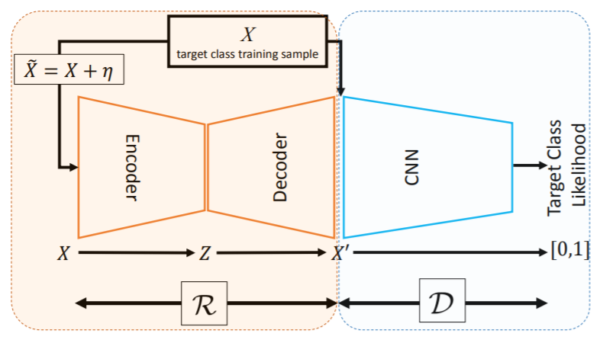
Adversarially Learned One-Class Classifier for Novelty Detection
Sabokrou, Mohammad, et al. "Adversarially learned one-class classifier for novelty detection." Proceedings of the IEEE Conference on Computer Vision and Pattern Recognition. 2018.
Notes:
https://arxiv.org/pdf/1802.09088.pdf

Slide 20
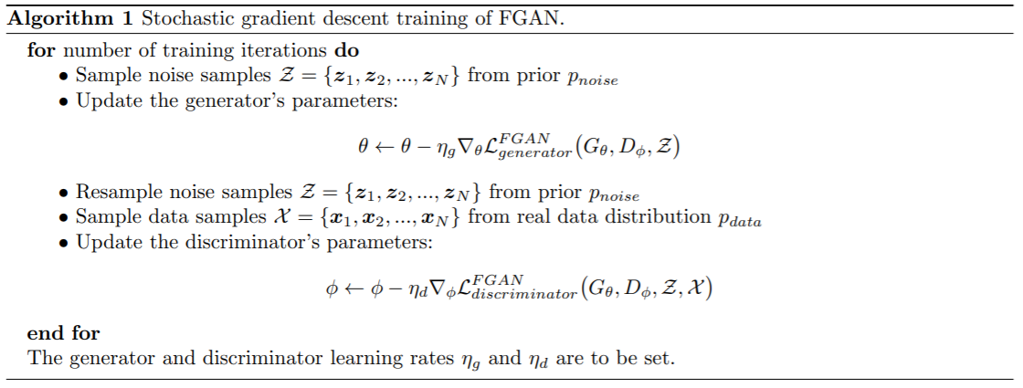
Fence GAN
Ngo, Cuong Phuc, et al. "Fence GAN: Towards Better Anomaly Detection." arXiv preprint arXiv:1904.01209 (2019).
Notes:
https://tongtianta.site/paper/36724 Fence GAN: Towards Better Anomaly Detection
https://arxiv.org/abs/1904.01209

Slide 21
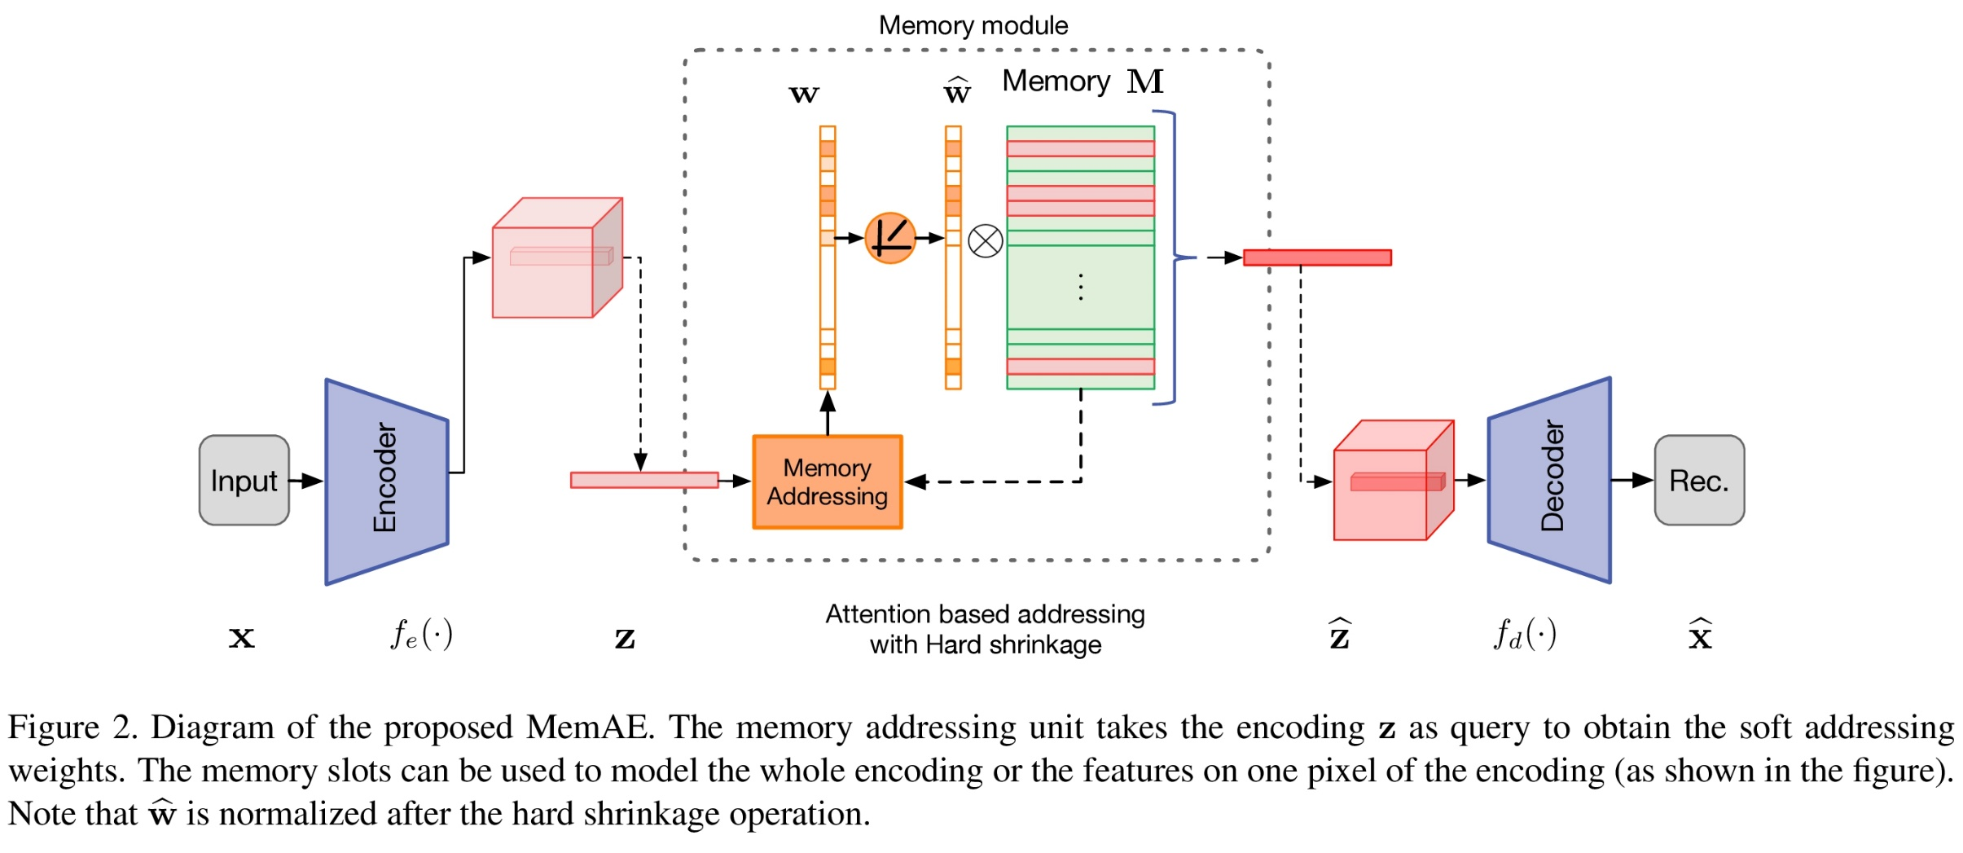
MemAE
Gong, Dong, et al. "Memorizing Normality to Detect Anomaly: Memory-augmented Deep Autoencoder for Unsupervised Anomaly Detection." arXiv preprint arXiv:1904.02639 (2019).
Notes:
https://github.com/h19920918/memae
Memorizing Normality to Detect Anomaly: Memory-augmented Deep Autoencoder for Unsupervised Anomaly Detection (MemAE)
https://tongtianta.site/paper/37335 Memorizing Normality to Detect Anomaly: Memory-augmented Deep Autoencoder for Unsupervised Anomaly Detection
https://github.com/donggong1/memae-anomaly-detection
https://arxiv.org/pdf/1904.02639.pdf

Slide 22
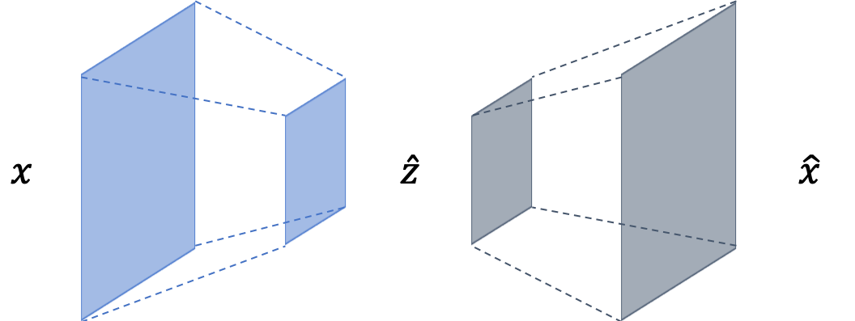
CVAE
Notes:
https://github.com/YeongHyeon/CVAE-AnomalyDetection
https://github.com/ninnart-fuengfusin/convolutional-anomaly-detection-autoencoder
https://github.com/shinmura0/AutoEncoder_vs_MetricLearning

Slide 23
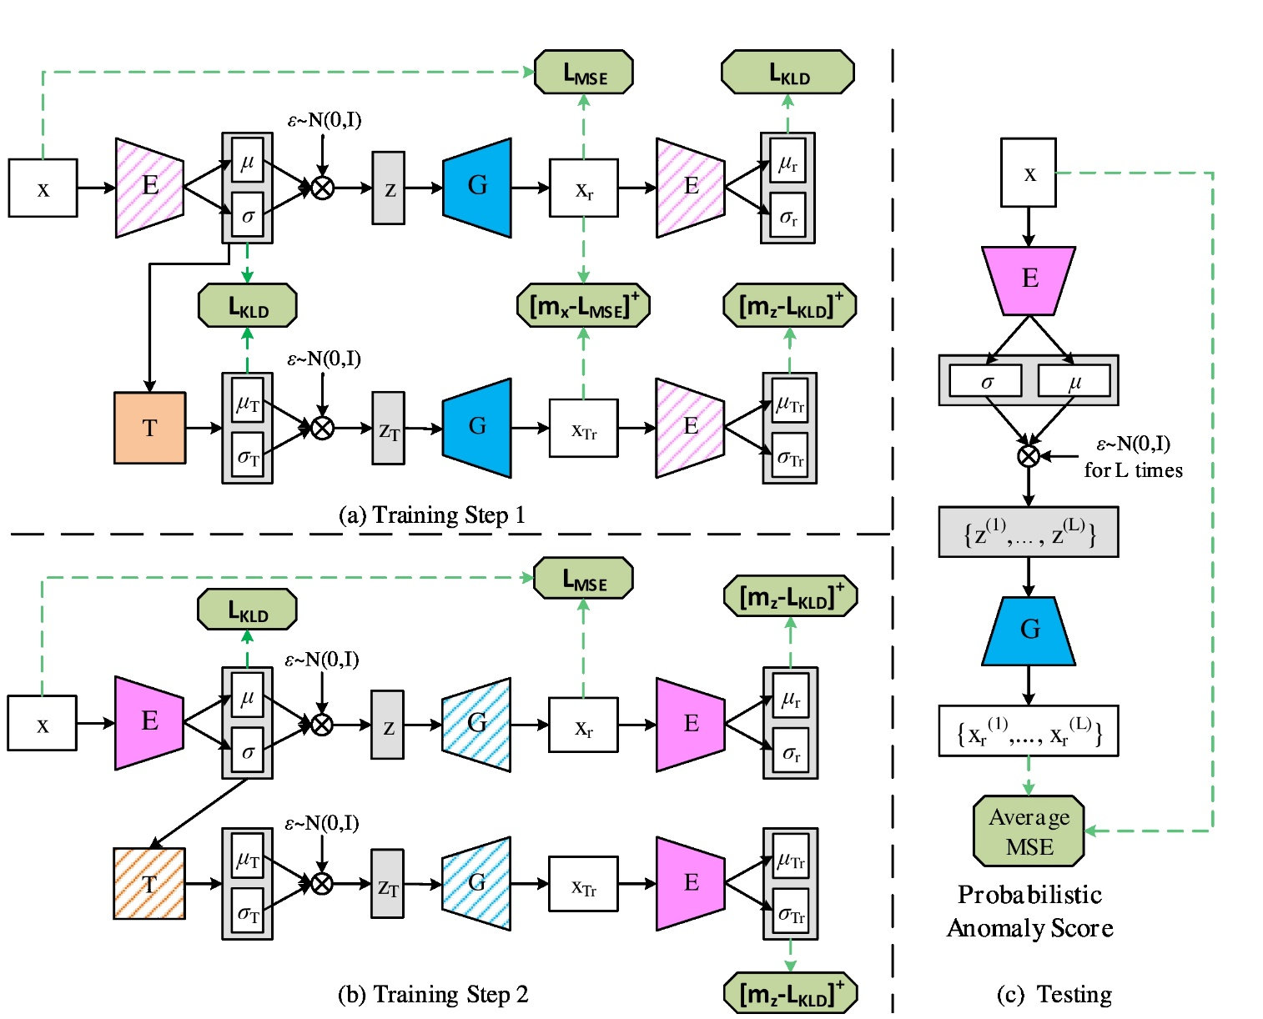
adVAE
Wang, Xuhong, et al. "Self-adversarial Variational Autoencoder with Gaussian Anomaly Prior Distribution for Anomaly Detection." arXiv preprint arXiv:1903.00904 (2019).
Notes:
https://github.com/YeongHyeon/adVAE
https://github.com/YeongHyeon/CVAE-AnomalyDetection
Self-Adversarial Variational Autoencoder with Gaussian Anomaly Prior Distribution for Anomaly Detection
https://tongtianta.site/paper/52769 Self-adversarial Variational Autoencoder with Gaussian Anomaly Prior Distribution for Anomaly Detection
https://github.com/WangXuhongCN/adVAE adVAE: a Self-adversarial Variational Autoencoder with Gaussian Anomaly Prior Knowledge for Anomaly Detection

Slide 24
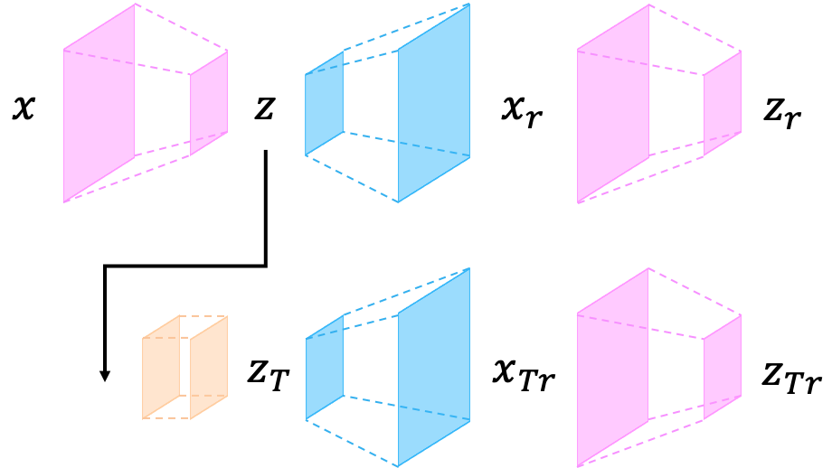
adVAE
Notes:
https://github.com/YeongHyeon/adVAE
https://github.com/YeongHyeon/CVAE-AnomalyDetection
Self-Adversarial Variational Autoencoder with Gaussian Anomaly Prior Distribution for Anomaly Detection
https://github.com/WangXuhongCN/adVAE
https://tongtianta.site/paper/52769

Slide 25
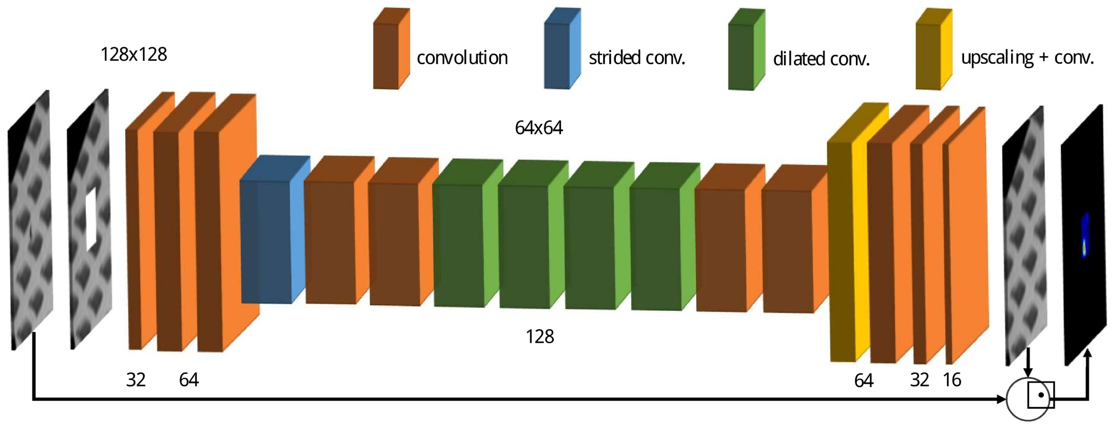
CompactCNN
Notes:
https://github.com/msminhas93/CompactCNN
A Compact Convolutional Neural Network for Textured Surface Anomaly Detection
https://tongtianta.site/paper/51924
http://arxiv.org/pdf/1811.06861v1.pdf
https://www.semanticscholar.org/paper/A-Compact-Convolutional-Neural-Network-for-Textured-Racki-Tomazevic/17d3f90cb63fbac50a5e49b8a46e633ec1f526fd#extracted

Slide 26
Image Completion
Notes:
https://arxiv.org/pdf/1811.06861.pdf Anomaly Detection using Deep Learning based Image Completion
https://github.com/oezguensi/anomaly-detection-image-completion

Slide 27
Doping
Lim, Swee Kiat, et al. "Doping: Generative data augmentation for unsupervised anomaly detection with gan." 2018 IEEE International Conference on Data Mining (ICDM). IEEE, 2018.
Notes:
https://github.com/greentfrapp/doping

Slide 28
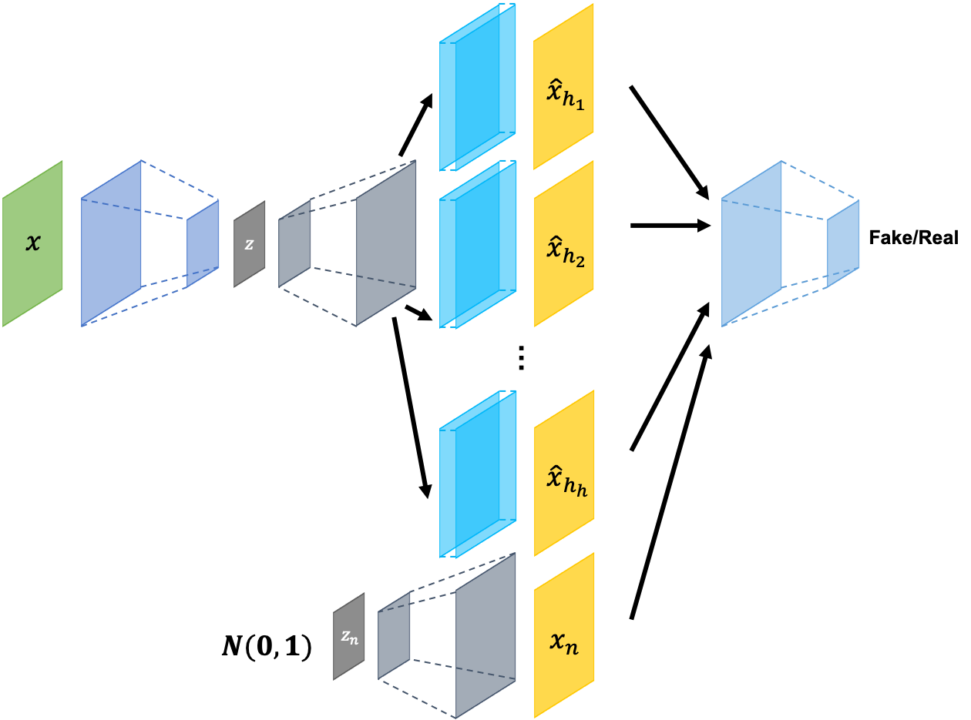
ConAD
Notes:
https://github.com/YeongHyeon/ConAD Anomaly Detection With Multiple-Hypotheses Predictions
https://arxiv.org/abs/1810.13292
https://github.com/YeongHyeon/CVAE-AnomalyDetection

Slide 29
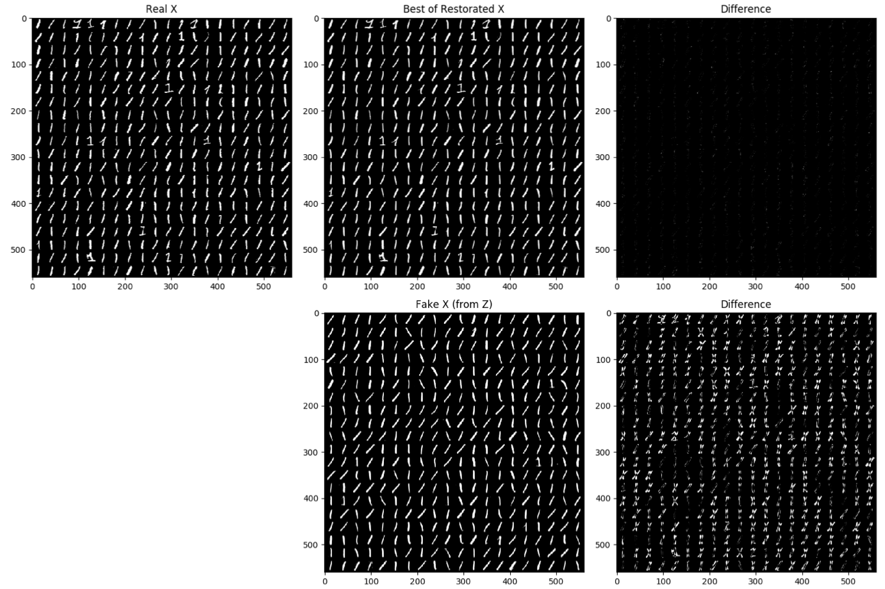
ConAD
Notes:
https://github.com/YeongHyeon/ConAD Anomaly Detection With Multiple-Hypotheses Predictions
https://arxiv.org/abs/1810.13292
https://github.com/YeongHyeon/CVAE-AnomalyDetection

Slide 30
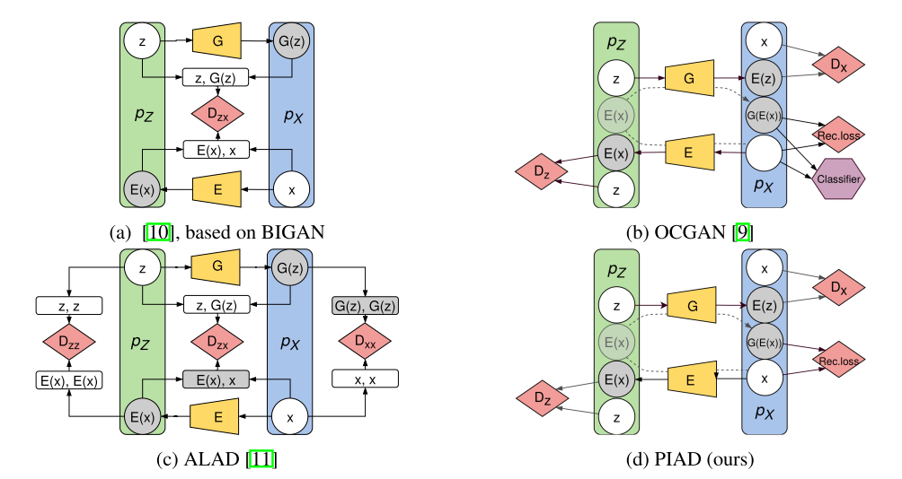
Perceptual Image Anomaly Detection
Notes:
Perceptual Image Anomaly Detection

Slide 31
Adversarially Learned Anomaly Detection
Adversarially Learned Anomaly Detection" (authors: Houssam Zenati*, Manon Romain*, Chuan Sheng Foo*, Bruno Lecouat, Vijay Ramaseshan Chandrasekhar)
Notes:
https://github.com/houssamzenati/Adversarially-Learned-Anomaly-Detection

Slide 32
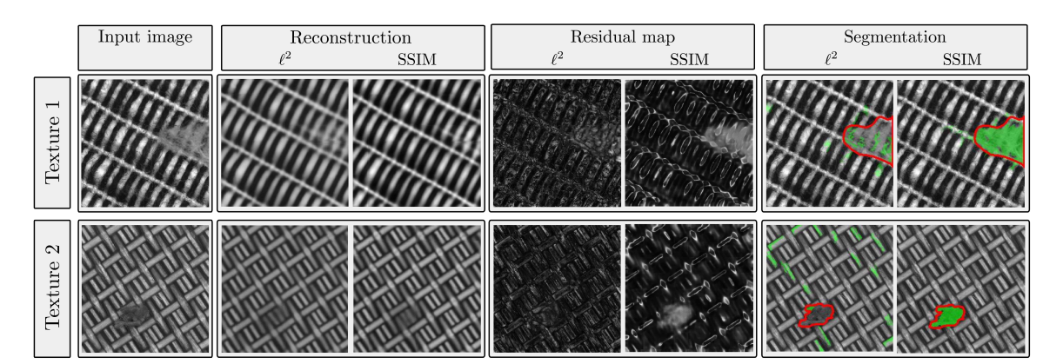
SSIM loss
Bergmann, Paul, et al. "Improving Unsupervised Defect Segmentation by Applying Structural Similarity to Autoencoders." arXiv preprint arXiv:1807.02011 (2018).

Slide 33
patch_gan_alocc
Notes:
https://github.com/jingkunchen/patch_gan_alocc

Slide 34
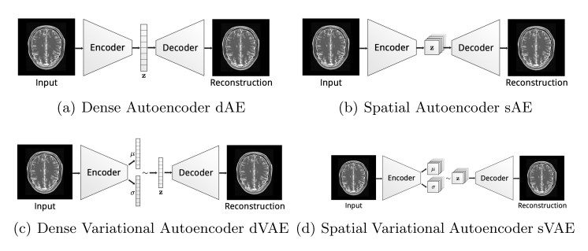
Spatial VAE
Baur, Christoph, et al. "Deep autoencoding models for unsupervised anomaly segmentation in brain mr images." International MICCAI Brainlesion Workshop. Springer, Cham, 2018.
Notes:
https://github.com/divelab/svae
https://github.com/tbepler/spatial-VAE
http://tongtianta.site/paper/61488
http://tongtianta.site/paper/61141

Slide 35
Deep Structured Energy Based Models
Notes:
Iterative energy-based projection on a normal data manifold for anomaly localization http://tongtianta.site/paper/59419
Deep structured energy-based image inpainting
http://tongtianta.site/paper/25792 Deep structured energy-based image inpainting
Deep Structured Energy Based Models for Anomaly Detection https://arxiv.org/abs/1605.07717
https://tongtianta.site/paper/63419
http://proceedings.mlr.press/v48/zhai16.pdf
https://github.com/yli96/DSEBM Deep Structured Energy Based Model

Slide 36
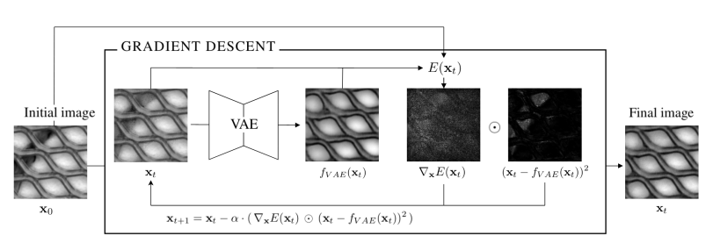
Structured Energy-Based VAE
Notes:
Iterative energy-based projection on a normal data manifold for anomaly localization http://tongtianta.site/paper/59419
Deep structured energy-based image inpainting
http://tongtianta.site/paper/25792 Deep structured energy-based image inpainting
Deep Structured Energy Based Models for Anomaly Detection https://arxiv.org/abs/1605.07717
https://tongtianta.site/paper/63419

Slide 37
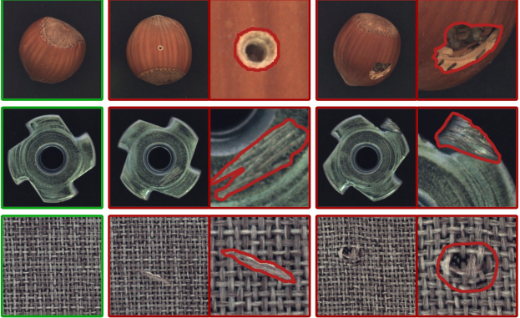
DataSet
Bergmann, Paul, et al. "MVTec AD--A Comprehensive Real-World Dataset for Unsupervised Anomaly Detection." Proceedings of the IEEE Conference on Computer Vision and Pattern Recognition. 2019.

Slide 38
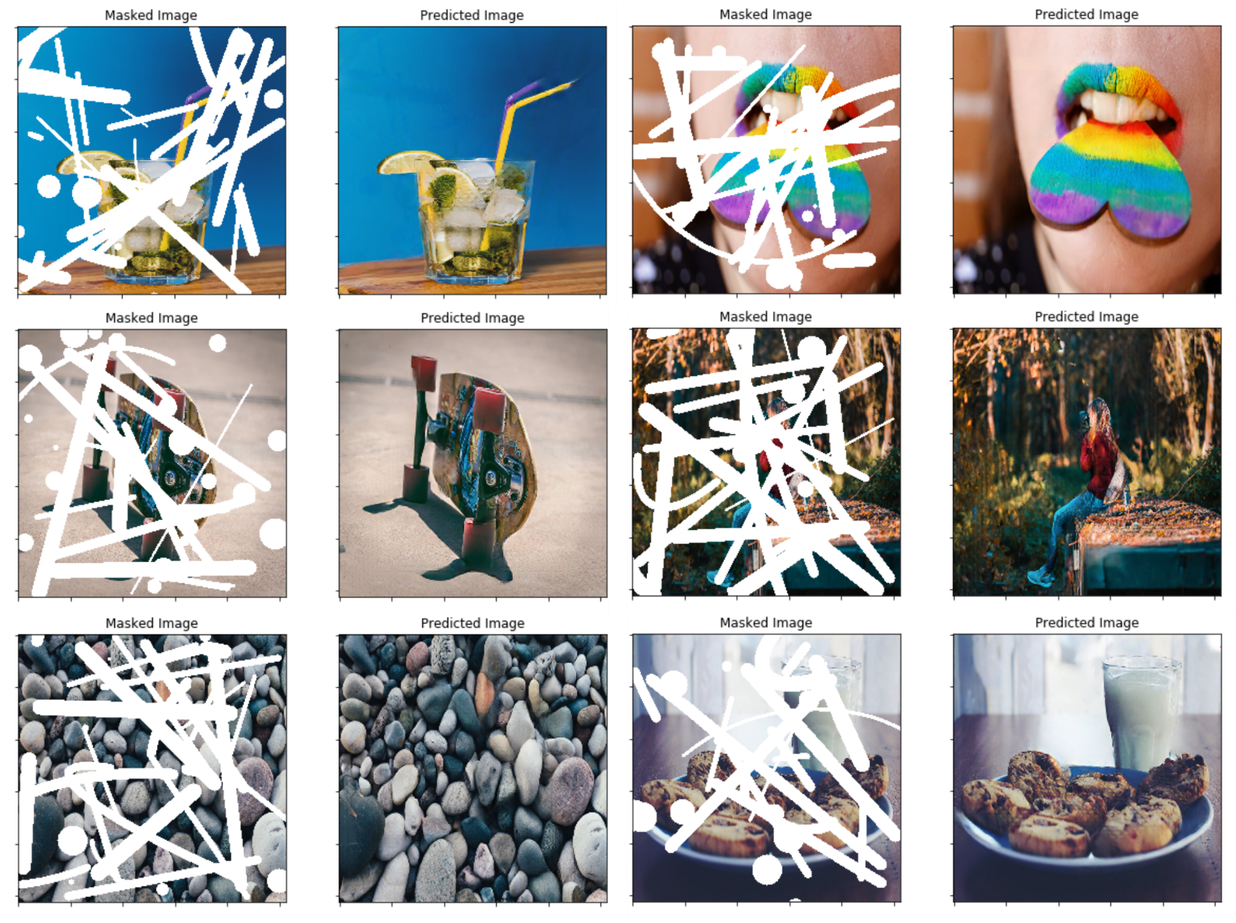
Partial Convolutions for Image Inpainting
Liu, Guilin, et al. "Image inpainting for irregular holes using partial convolutions." Proceedings of the European Conference on Computer Vision (ECCV). 2018.
Notes:
https://qiita.com/shinmura0/items/742adb4faefcfc8dd5cb
https://github.com/shinmura0/PConv-Keras

Slide 39
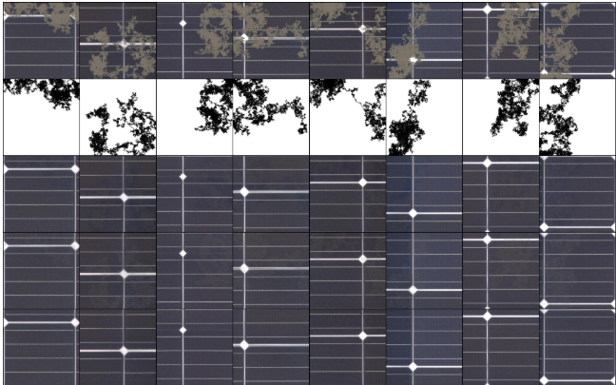
Partial Convolutions
Notes:
https://qiita.com/shinmura0/items/742adb4faefcfc8dd5cb
https://github.com/shinmura0/PConv-Keras

Slide 40
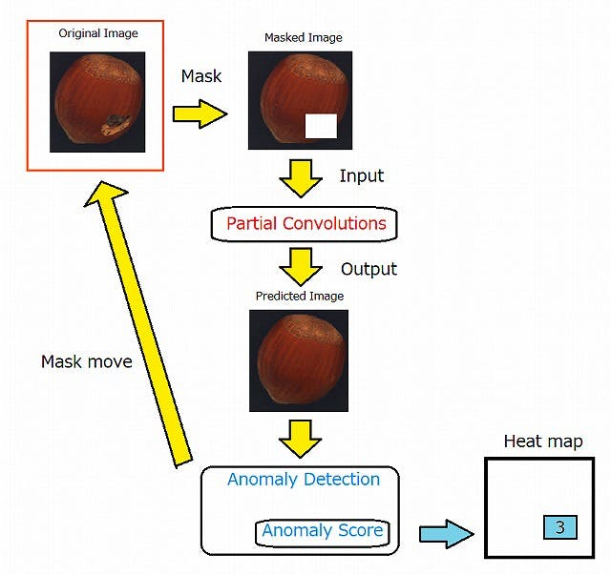
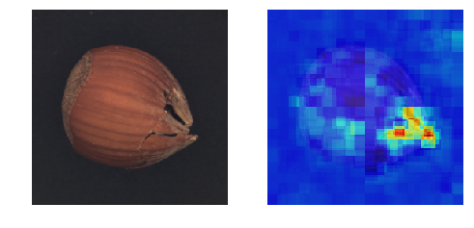
Ano-Unet
Notes:
https://qiita.com/shinmura0/items/742adb4faefcfc8dd5cb
https://github.com/shinmura0/PConv-Keras

Slide 41
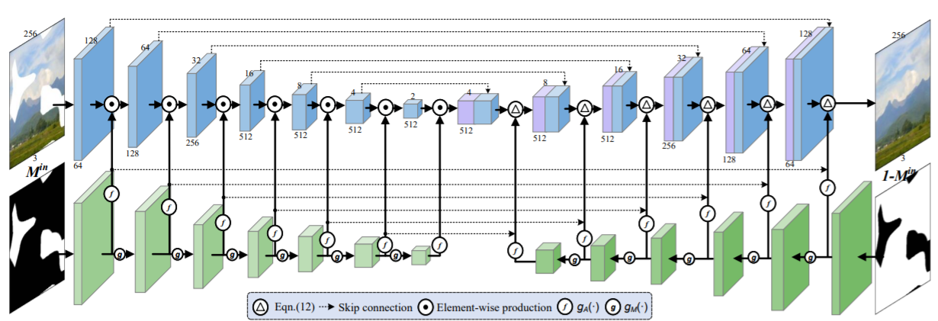
Pluralistic-Inpainting
Xie, Chaohao, et al. "Image Inpainting with Learnable Bidirectional Attention Maps." arXiv preprint arXiv:1909.00968 (2019).

Slide 42
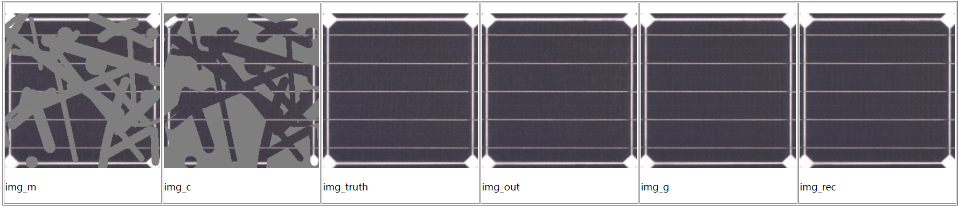
Pluralistic-Inpainting
Xie, Chaohao, et al. "Image Inpainting with Learnable Bidirectional Attention Maps." arXiv preprint arXiv:1909.00968 (2019).

Slide 43
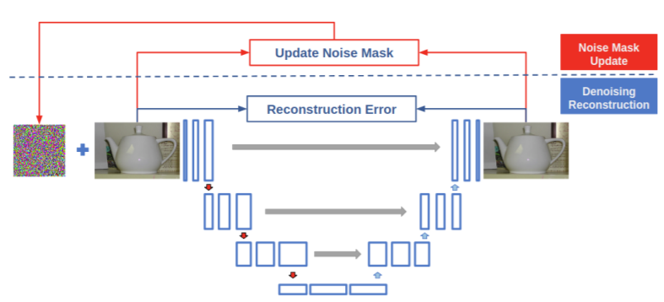
PNUNet
Kimura, Masanari. "PNUNet: Anomaly Detection using Positive-and-Negative Noise based on Self-Training Procedure." arXiv preprint arXiv:1905.10939 (2019).
Notes:
https://arxiv.org/pdf/1905.10939v1.pdf
PNUNet: Anomaly Detection using Positive-and-Negative Noise based on Self-Training Procedure

Slide 44
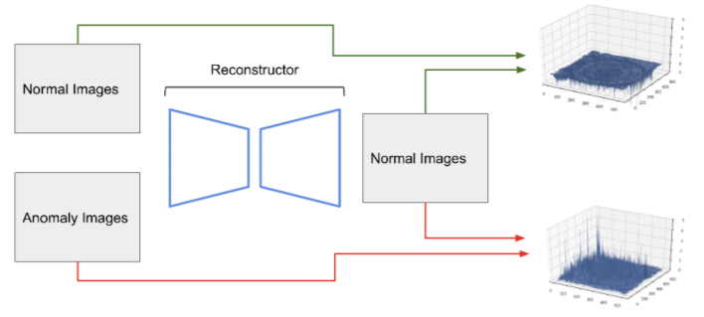
PNUNet
Kimura, Masanari. "PNUNet: Anomaly Detection using Positive-and-Negative Noise based on Self-Training Procedure." arXiv preprint arXiv:1905.10939 (2019).
Notes:
https://arxiv.org/pdf/1905.10939v1.pdf
PNUNet: Anomaly Detection using Positive-and-Negative Noise based on Self-Training Procedure

